Slide 1
Bird Species Observation Analysis
Forests vs Grasslands | Data-Driven Insights for Conservation

Slide 2
Introduction
This project analyzes bird species observations across two habitats: forests and grasslands.
The aim is to understand diversity patterns, seasonal trends, and environmental influences.
Insights support biodiversity conservation, eco-tourism, and habitat management.

Slide 3
Objectives
- Compare species diversity between habitats.
- Analyze seasonal and yearly observation trends.
- Study the effect of environmental factors.
- Identify top observed species.
- Provide actionable recommendations.

Slide 4
Methodology
Data cleaning steps:
• Standardized column names and formats.
• Removed incomplete or invalid records.
• Parsed date into year, month, and season.
• Converted environmental data to numeric types.
EDA tools used: Python (Pandas, Matplotlib, Plotly).

Slide 5
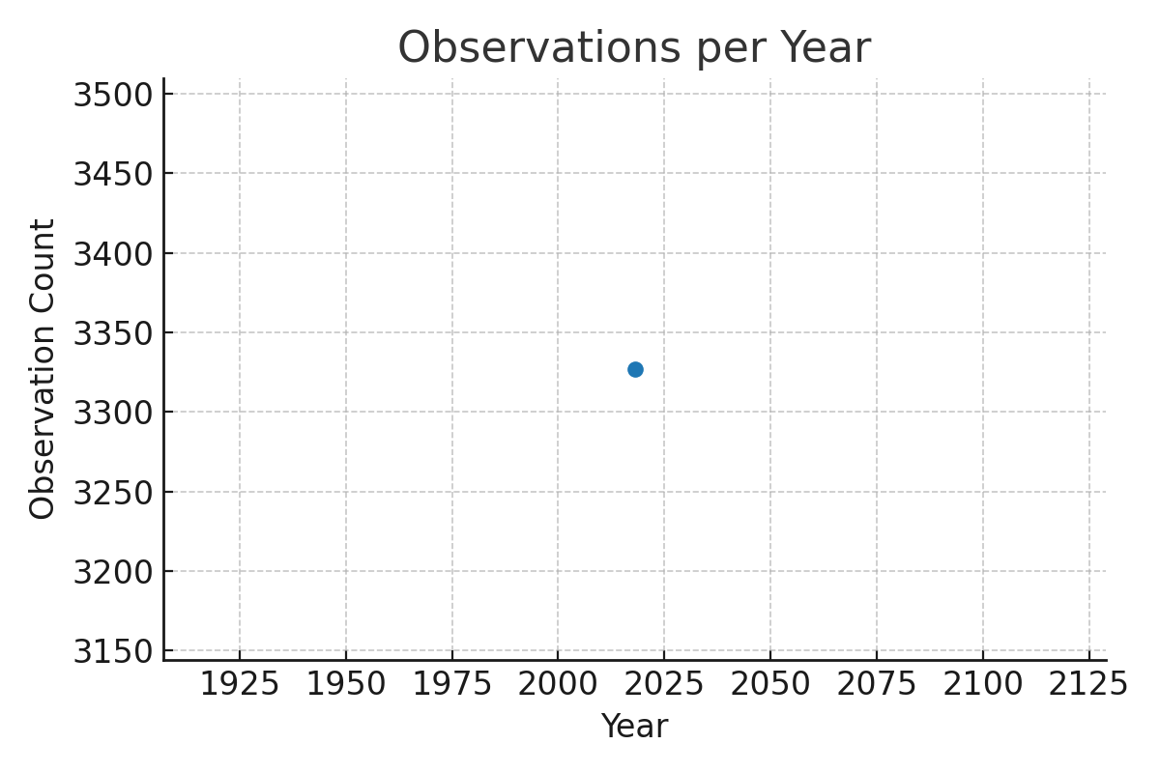
Observations per Year

Slide 6
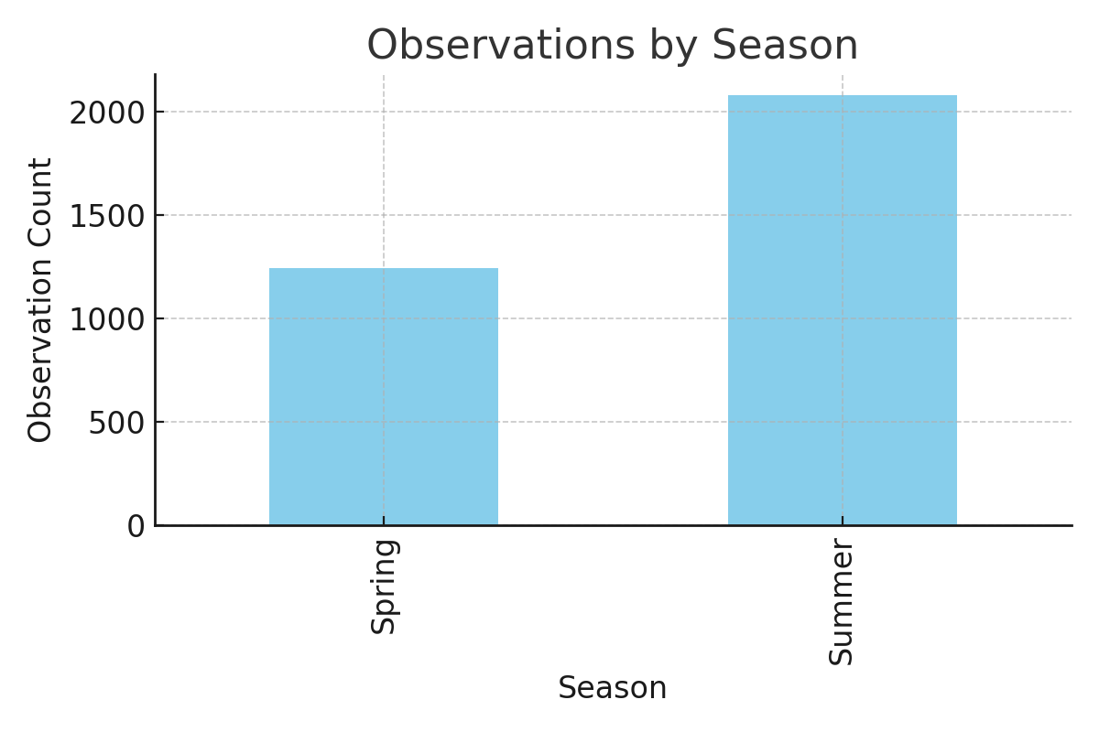
Observations by Season

Slide 7
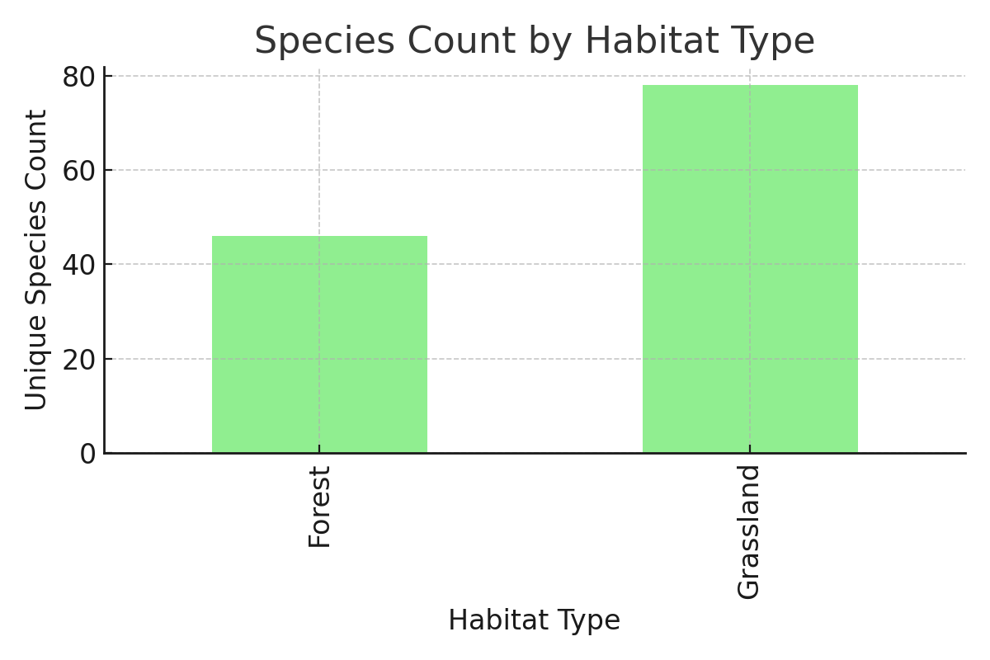
Species Count by Habitat Type

Slide 8
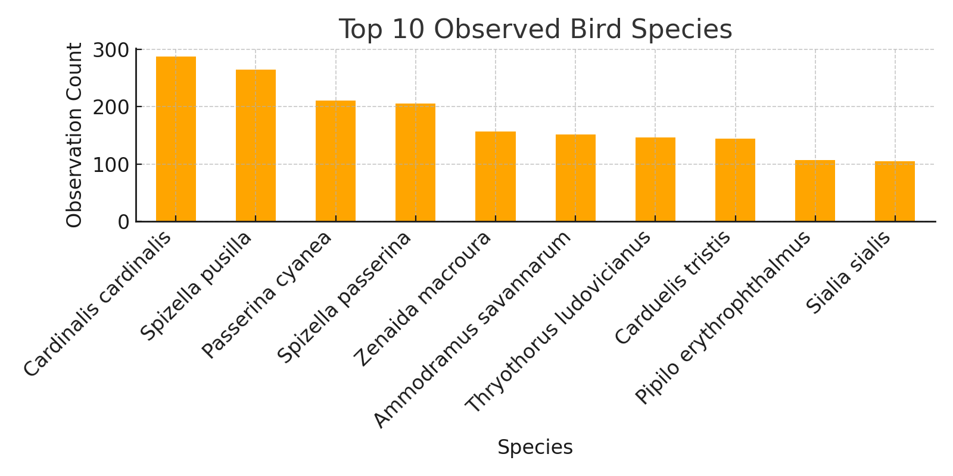
Top 10 Observed Bird Species

Slide 9
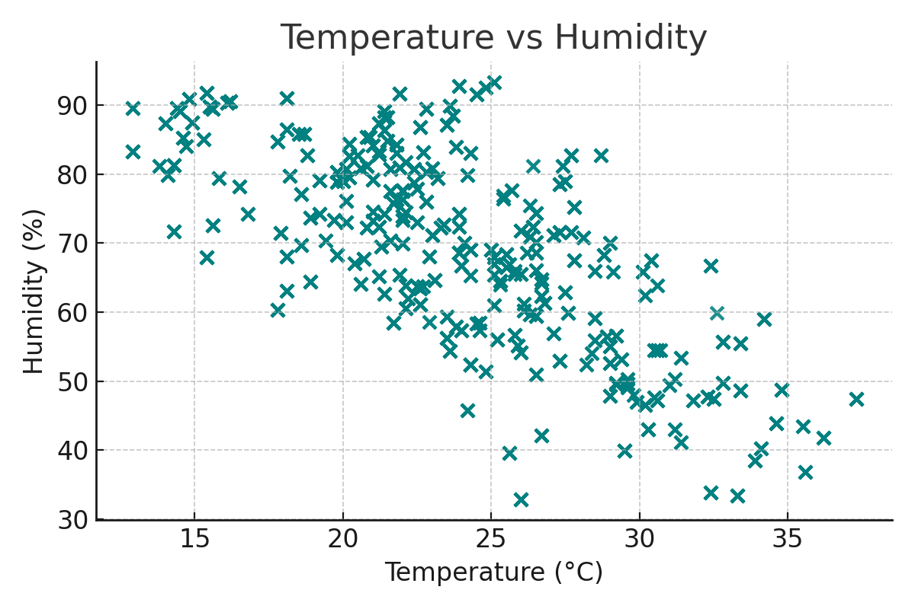
Temperature vs Humidity

Slide 10
Insights
- Forest habitats show slightly higher species diversity.
- Seasonal peaks suggest migration/breeding influences.
- Temperature and humidity impact sightings.
- Certain species dominate observations.

Slide 11
Recommendations
- Prioritize conservation in high-diversity habitats.
- Track environmental conditions during peak seasons.
- Broaden observer participation to reduce bias.
- Study less observed species for conservation needs.

Slide 12
Conclusion
Data-driven analysis reveals valuable patterns in bird distribution and activity.
These findings can guide conservation strategies, habitat management, and eco-tourism initiatives.

